Slide 1
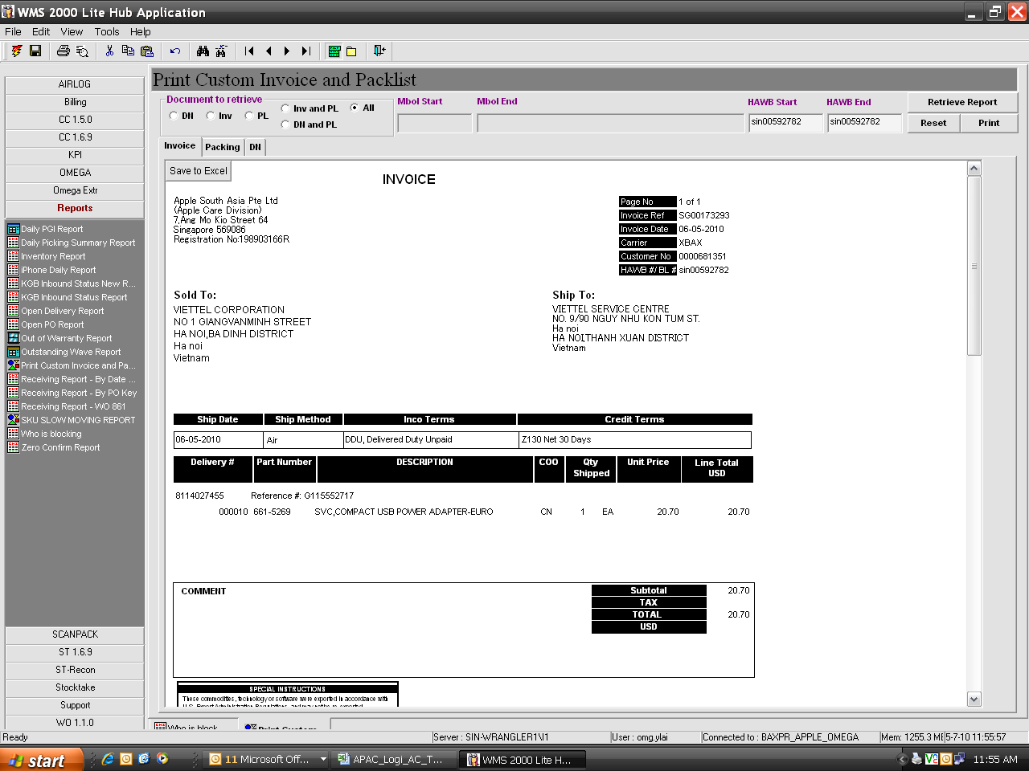
1- Printed doc change to 3 copy per click
2- printed doc 1st copy blank paper
3- for segregate printed doc to group , no sorting of doc require by admin

